Slide 1
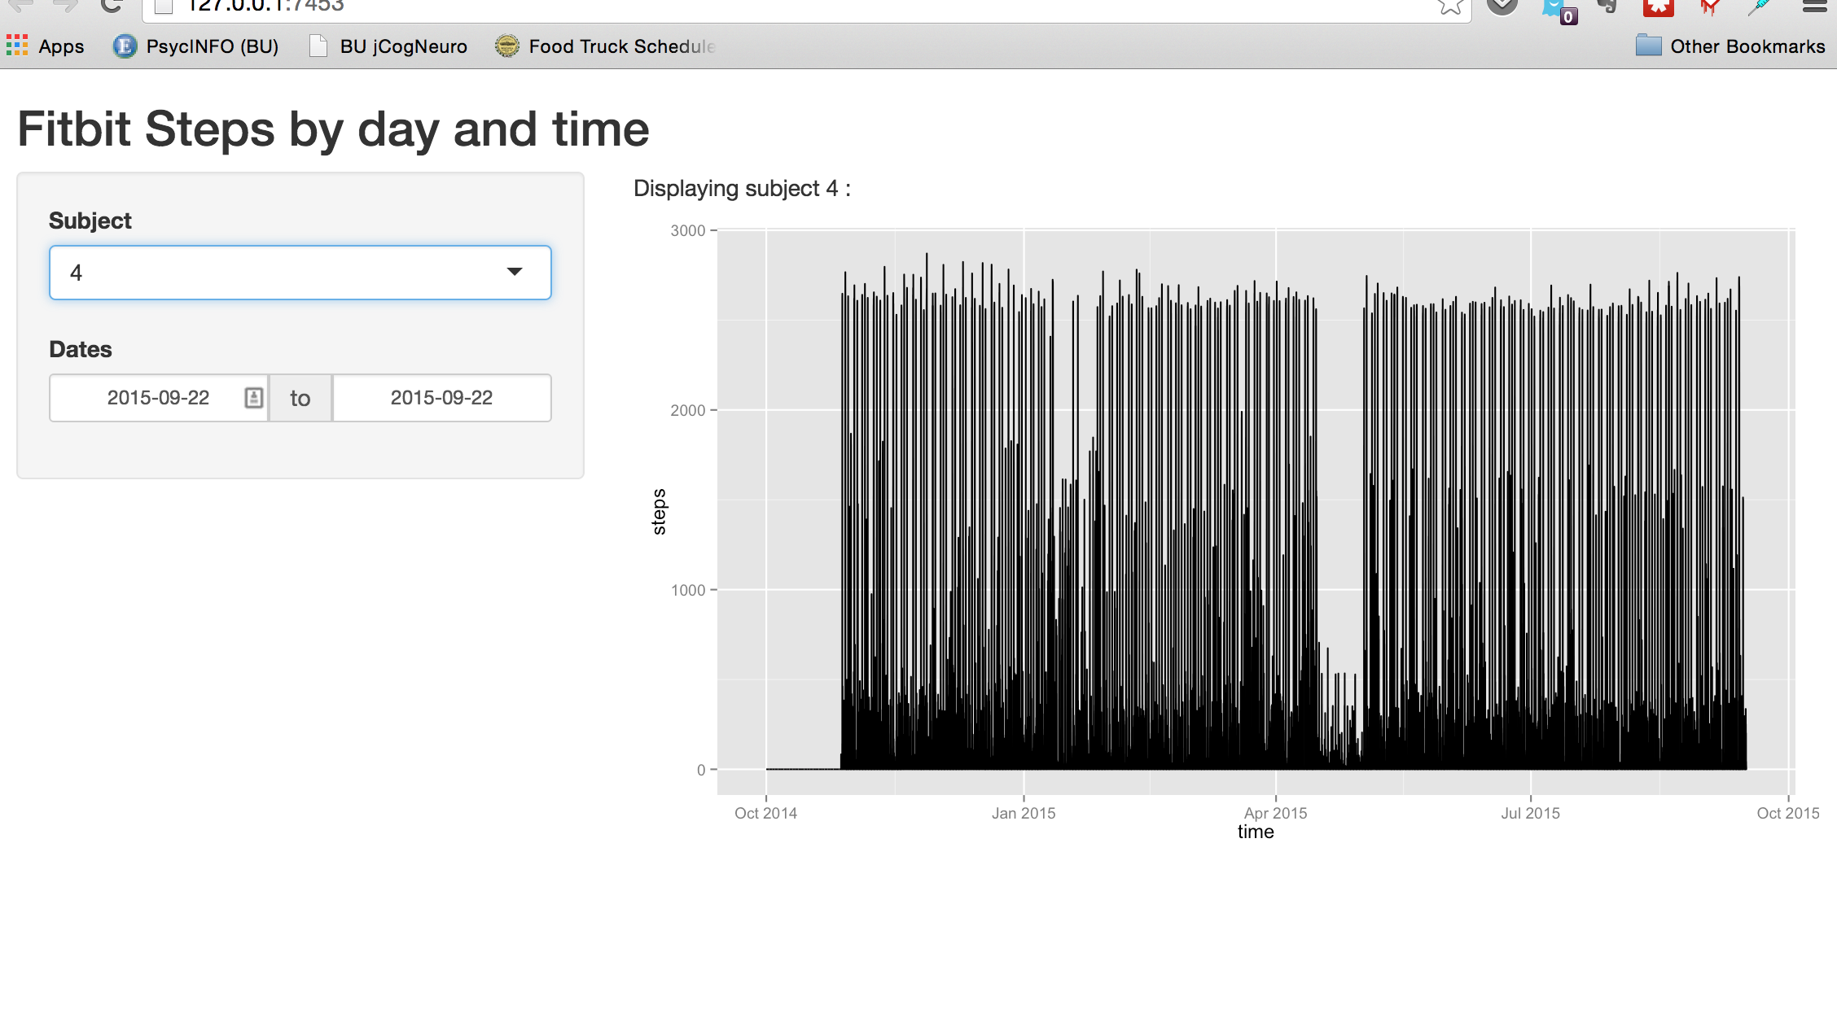
Fitbit
Notes:
Goal: Scrape our own fitbit sleep and step data and create a shiny app.
We want to examine patterns of activity at different times of the day and day of the week and we want to look at how sleep duration varies with steps.
Challenges thus far: Sleep data was at daily level and step data was at 15 min. intervals and merging the two across the time scales and individuals was a challenge.
We then computed total daily steps for each person within each day. Next we are going to update the shiny app to view steps by day of the week and time of day

